Slide 1
Lecture 14b: Cloud Resource Virtualization
This lecture primarily drawn from Chapter 10 of textbook

Slide 2
Main Topics
Virtualization.
Layering and virtualization.
Virtual machine monitor.
Virtual machine.
Performance and security isolation.
Architectural support for virtualization.
x86 support for virtualization.
Full and paravirtualization.
Xen 1.0 and Xen 2.0.
Performance comparison of virtual machine monitors.
The darker side of virtualization.
Security risks.

Slide 3
Motivation
There are many physical realizations of the fundamental abstractions necessary to describe the operation of a computing systems.
Interpreters.
Memory.
Communications links.
Virtualization is a basic tenet of cloud computing, it simplifies the management of physical resources for the three abstractions.
The state of a virtual machine (VM) running under a virtual machine monitor (VMM) can de saved and migrated to another server to balance the load.
Virtualization allows users to operate in environments they are familiar with, rather than forcing them to idiosyncratic ones.
Cloud resource virtualization is important for:
System security, as it allows isolation of services running on the same hardware.
Performance and reliability, as it allows applications to migrate from one platform to another.
The development and management of services offered by a provider.
Performance isolation.

Slide 4
Virtualization
Simulates the interface to a physical object by:
Multiplexing: creates multiple virtual objects from one instance of a physical object. Example - a processor is multiplexed among a number of processes or threads.
Aggregation: creates one virtual object from multiple physical objects. Example - a number of physical disks are aggregated into a RAID disk.
Emulation: constructs a virtual object from a different type of a physical object. Example - a physical disk emulates a Random Access Memory (RAM).
Multiplexing and emulation. Examples - virtual memory with paging multiplexes real memory and disk; a virtual address emulates a real address.

Slide 5
Layering
Layering – a common approach to manage system complexity.
Minimizes the interactions among the subsystems of a complex system.
Simplifies the description of the subsystems; each subsystem is abstracted through its interfaces with the other subsystems.
We are able to design, implement, and modify the individual subsystems independently.
Layering in a computer system.
Hardware.
Software.
Operating system.
Libraries.
Applications.

Slide 6
Interfaces
Instruction Set Architecture (ISA) – at the boundary between hardware and software.
Application Binary Interface (ABI) – allows the ensemble consisting of the application and the library modules to access the hardware; the ABI does not include privileged system instructions, instead it invokes system calls.
Application Program Interface (API) - defines the set of instructions the hardware was designed to execute and gives the application access to the ISA; it includes HLL library calls which often invoke system calls.

Slide 7
Application Programming Interface, Application Binary Interface, and Instruction Set Architecture . An application uses library functions (A1), makes system calls (A2), and executes machine instructions (A3).

Slide 8
Code portability
Binaries created by a compiler for a specific ISA and a specific operating systems are not portable.
It is possible, though, to compile a HLL program for a virtual machine (VM) environment where portable code is produced and distributed and then converted by binary translators to the ISA of the host system.
A dynamic binary translation converts blocks of guest instructions from the portable code to the host instruction and leads to a significant performance improvement, as such blocks are cached and reused

Slide 10
Activity #1
What is the purpose of virtualization?
What interface(s) does the virtualization simulate?

Slide 11
Virtual machine monitor (VMM / hypervisor)
Partitions the resources of computer system into one or more virtual machines (VMs). Allows several operating systems to run concurrently on a single hardware platform.
A VMM allows
Multiple services to share the same platform.
Live migration - the movement of a server from one platform to another.
System modification while maintaining backward compatibility with the original system.
Enforces isolation among the systems, thus security.

Slide 12
VMM virtualizes the CPU and the memory
A VMM
Traps the privileged instructions executed by a guest OS and enforces the correctness and safety of the operation.
Traps interrupts and dispatches them to the individual guest operating systems.
Controls the virtual memory management.
Maintains a shadow page table for each guest OS and replicates any modification made by the guest OS in its own shadow page table. This shadow page table points to the actual page frame and it is used by the Memory Management Unit (MMU) for dynamic address translation.
Monitors the system performance and takes corrective actions to avoid performance degradation. For example, the VMM may swap out a Virtual Machine to avoid thrashing.

Slide 13
Virtual machines (VMs)
VM - isolated environment that appears to be a whole computer, but actually only has access to a portion of the computer resources.
Process VM - a virtual platform created for an individual process and destroyed once the process terminates.
System VM - supports an operating system together with many user processes.
Traditional VM - supports multiple virtual machines and runs directly on the hardware.
Hybrid VM - shares the hardware with a host operating system and supports multiple virtual machines.
Hosted VM - runs under a host operating system.

Slide 14
Traditional, hybrid, and hosted VMs
A taxonomy of process and system VMs for the same and different ISAs. Traditional, hybrid, and hosted are three classes of VMs with same ISA.
Traditional VMs; the hypervisor supports multiple VMs and runs directly on the hardware.
Hybrid VMs; the hypervisor shares the hardware with a host OS and supports multiple VMs.
Hosted VM; the hypervisor runs under a host OS.
Figure 10.1

Slide 15
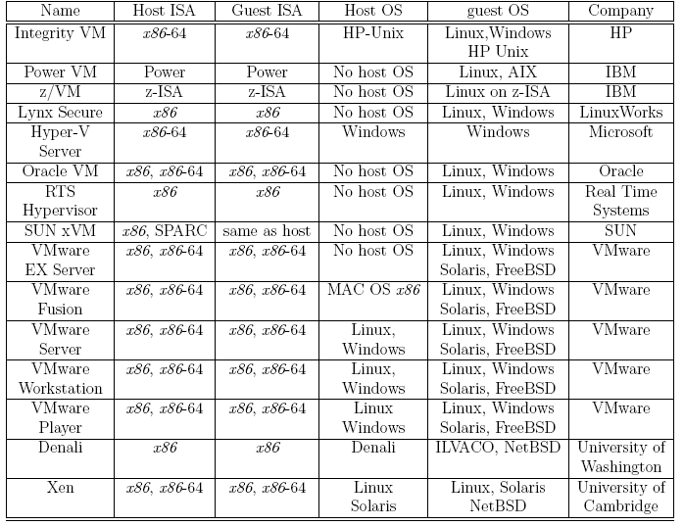

Slide 16
Performance and security isolation
The run-time behavior of an application is affected by other applications running concurrently on the same platform and competing for CPU cycles, cache, main memory, disk and network access. Thus, it is difficult to predict the completion time!
Performance isolation - a critical condition for QoS guarantees in shared computing environments.
A VMM is a much simpler and better specified system than a traditional operating system. Example - Xen has approximately 60,000 lines of code; Denali has only about half, 30,000.
The security vulnerability of VMMs is considerably reduced as the systems expose a much smaller number of privileged functions.

Slide 17
Activity #2
True or False.
In the traditional VMs, a hypervisor can only support one VM.
In the traditional VMs, a hypervisor runs directly on the hardware.
In the hosted VMs, a hypervisor shares the hardware with a host OS.
Hybrid VMs and Hosted VMs use different ISA.

Slide 18
Computer architecture and virtualization
Conditions for efficient virtualization:
A program running under the VMM should exhibit a behavior essentially identical to that demonstrated when running on an equivalent machine directly.
The VMM should be in complete control of the virtualized resources.
A statistically significant fraction of machine instructions must be executed without the intervention of the VMM.
Two classes of machine instructions:
Sensitive - require special precautions at execution time:
Control sensitive - instructions that attempt to change either the memory allocation or the privileged mode.
Mode sensitive - instructions whose behavior is different in the privileged mode.
Innocuous - not sensitive.

Slide 19
Full virtualization and paravirtualization
Full virtualization – a guest OS can run unchanged under the VMM as if it was running directly on the hardware platform.
Requires a virtualizable architecture.
Examples: Vmware.
Paravirtualization - a guest operating system is modified to use only instructions that can be virtualized. Reasons for paravirtualization:
Some aspects of the hardware cannot be virtualized.
Improved performance.
Present a simpler interface.
Examples: Xen, Denaly

Slide 20
Full virtualization and paravirtualization
Figure 10.2
(A) Full virtualization requires the hardware abstraction layer of the guest OS to have some knowledge about the processor architecture. The guest OS runs unchanged. This virtualization mode is more efficient than paravirtualization.
(B) Paravirtualization is used when the processor architecture is not easily virtualizable. The hardware abstraction layer of the guest OS does not have knowledge about the hardware. The guest OS is modified to run under the hypervisor and must be ported to individual hardware platforms.

Slide 21
Virtualization of x86 architecture
Ring de-privileging - a VMMs forces the operating system and the applications to run at a privilege level greater than 0.
Ring aliasing - a guest OS is forced to run at a privilege level other than that it was originally designed for.
Address space compression - a VMM uses parts of the guest address space to store several system data structures.
Non-faulting access to privileged state - several store instructions can only be executed at privileged level 0 because they operate on data structures that control the CPU operation. They fail silently when executed at a privilege level other than 0.
Guest system calls which cause transitions to/from privilege level 0 must be emulated by the VMM.
Interrupt virtualization - in response to a physical interrupt, the VMM generates a ``virtual interrupt'' and delivers it later to the target guest OS which can mask interrupts.

Slide 22
Virtualization of x86 architecture (cont’d)
Access to hidden state - elements of the system state, e.g., descriptor caches for segment registers, are hidden; there is no mechanism for saving and restoring the hidden components when there is a context switch from one VM to another.
Ring compression - paging and segmentation protect VMM code from being overwritten by guest OS and applications. Systems running in 64-bit mode can only use paging, but paging does not distinguish between privilege levels 0, 1, and 2, thus the guest OS must run at privilege level 3, the so called (0/3/3) mode. Privilege levels 1 and 2 cannot be used thus, the name ring compression.
The task-priority register is frequently used by a guest OS; the VMM must protect the access to this register and trap all attempts to access it. This can cause a significant performance degradation.

Slide 23
VT-x, a major architectural enhancement
Supports two modes of operations:
VMX root - for VMM operations.
VMX non-root - support a VM.
The Virtual Machine Control Structure including host-state and guest-state areas.
VM entry - the processor state is loaded from the guest-state of the VM scheduled to run; then the control is transferred from VMM to the VM.
VM exit - saves the processor state in the guest-state area of the running VM; then it loads the processor state from the host-state area, finally transfers control to the VMM.

Slide 24
VT- x
Figure 10.3
The two nodes of operation of VT-x. and the two operations to transit from one to another.
VMCS includes host-state and guest-state which control the VM entry and VM exit transitions.

Slide 25
VT-d, a new virtualization architecture
I/O MMU virtualization gives VMs direct access to peripheral devices.
VT-d supports:
DMA address remapping, address translation for device DMA transfers.
Interrupt remapping, isolation of device interrupts and VM routing.
I/O device assignment, the devices can be assigned by an administrator to a VM in any configurations.
Reliability features, it reports and records DMA and interrupt errors that my otherwise corrupt memory and impact VM isolation.

Slide 26
Activity #3
What is a VM? What is a VMM?
Which of the following is not a type of VMs?
a. System VM b. Functional VM c. Process VM
3. True or False.
The guest OS in full virtualization does not have any knowledge about the processor architecture.
Full virtualization is less efficient than the paravirtualization.

Slide 27
Xen - a VMM based on paravirtualization
The goal of the Cambridge group - design a VMM capable of scaling to about 100 VMs running standard applications and services without any modifications to the Application Binary Interface (ABI).
Linux, Minix, NetBSD, FreeBSD, NetWare, and OZONE can operate as paravirtualized Xen guest OS running on x86, x86-64, Itanium, and ARM architectures.
Xen domain - ensemble of address spaces hosting a guest OS and applications running under the guest OS. Runs on a virtual CPU.
Dom0 - dedicated to execution of Xen control functions and privileged instructions.
DomU - a user domain.
Applications make system calls using hypercalls processed by Xen; privileged instructions issued by a guest OS are paravirtualized and must be validated by Xen.

Slide 28
Xen
Figure 10.4
Xen for the X86 architecture. The management OS dedicated to the execution of Xen control functions resides in Dom0. Guest OS and applications reside in DomU. A guest OS could be either XenoLinux, XenoBSD, or XenoXP in the original Xen implementation.

Slide 29
Xen implementation on x86 architecture
Xen runs at privilege Level 0, the guest OS at Level 1, and applications at Level 3.
The x86 architecture does not support either the tagging of TLB entries or the software management of the TLB. Thus, address space switching, when the VMM activates a different OS, requires a complete TLB flush; this has a negative impact on the performance.
Solution - load Xen in a 64 MB segment at the top of each address space and delegate the management of hardware page tables to the guest OS with minimal intervention from Xen. This region is not accessible or re-mappable by the guest OS.
Xen schedules individual domains using the Borrowed Virtual Time (BVT) scheduling algorithm.
A guest OS must register with Xen a description table with the addresses of exception handlers for validation.

Slide 30
Dom0 components
XenStore – a Dom0 process.
Supports a system-wide registry and naming service.
Implemented as a hierarchical key-value storage.
A watch function informs listeners of changes of the key in storage they have subscribed to.
Communicates with guest VMs via shared memory using Dom0 privileges.
Toolstack - responsible for creating, destroying, and managing the resources and privileges of VMs.
To create a new VM, a user provides a configuration file describing memory and CPU allocations and device configurations.
Toolstack parses this file and writes this information in XenStore.
Takes advantage of Dom0 privileges to map guest memory, to load a kernel and virtual BIOS and to set up initial communication channels with XenStore and with the virtual console when a new VM is created.

Slide 31
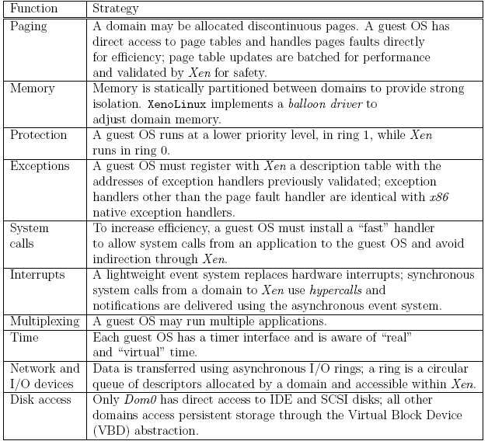
Paravirtualization strategies for virtual memory management, CPU multiplexing, and I/O devices.
Table 10.2

Slide 32
Xen abstractions for networking and I/O
Each domain has one or more Virtual Network Interfaces (VIFs) which support the functionality of a network interface card. A VIF is attached to a Virtual Firewall-Router (VFR).
Split drivers have a front-end in the DomU and the back-end in Dom0; the two communicate via a ring in shared memory.
Ring - a circular queue of descriptors allocated by a domain and accessible within Xen. Descriptors do not contain data, the data buffers are allocated off-band by the guest OS.
Two rings of buffer descriptors, one for packet sending and one for packet receiving, are supported.
To transmit a packet:
a guest OS enqueues a buffer descriptor to the send ring,
then Xen copies the descriptor and checks safety,
copies only the packet header, not the payload, and
executes the matching rules.

Slide 33
Xen zero-copy semantics for data transfer using I/O rings.
The communication between a guest domain and the driver domain over an I/O and an event channel; NIC is the Network Interface Controller.
the circular ring of buffers.
Figure 10.5

Slide 34
Xen 2.0
Optimization of:
Virtual interface - takes advantage of the capabilities of some physical NICs, such as checksum offload.
I/O channel - rather than copying a data buffer holding a packet, each packet is allocated in a new page and then the physical page containing the packet is re-mapped into the target domain.
Virtual memory - takes advantage of the superpage and global page mapping hardware on Pentium and Pentium Pro processors. A superpage entry covers 1,024 pages of physical memory and the address translation mechanism maps a set of contiguous pages to a set of contiguous physical pages. This helps reduce the number of TLB misses.

Slide 35
Figure 10.6
Xen network architecture. (a) The original architecture; (b) The optimized architecture

Slide 36
Performance comparison of virtual machines
Compare the performance of Xen and OpenVZwith, a standard operating system, a plain vanilla Linux.
The questions examined are:
How the performance scales up with the load?
What is the impact of a mix of applications?
What are the implications of the load assignment on individual servers?
The main conclusions:
The virtualization overhead of Xen is considerably higher than that of OpenVZ and that this is due primarily to L2-cache misses.
The performance degradation when the workload increases is also noticeable for Xen.
Hosting multiple tiers of the same application on the same server is not an optimal solution.

Slide 37
The setup for the performance comparison of a native Linux system with OpenVZ, and the Xen systems. The applications are a web server and a MySQL database server.
The first experiment, the web and the DB, share a single system;
The second experiment, the web and the DB, run on two different systems;
The third experiment, the web and the DB, run on two different systems and each has four instances.
Figure 10.13

Slide 38
Activity #4
What is a hypervisor?
What organization is it if “the hypervisor shares the hardware with an existing OS”?
a. Hybrid b. Hosted c. traditional d. OS-level virtualization
3. True or False. Xen always uses full-virtualization method.

Slide 39
The darker side of virtualization
In a layered structure, a defense mechanism at some layer can be disabled by malware running at a layer below it.
It is feasible to insert a rogue VMM, a Virtual-Machine Based Rootkit (VMBR) between the physical hardware and an operating system.
Rootkit - malware with a privileged access to a system.
The VMBR can enable a separate malicious OS to run surreptitiously and make this malicious OS invisible to the guest OS and to the application running under it.
Under the protection of the VMBR, the malicious OS could:
observe the data, the events, or the state of the target system.
run services, such as spam relays or distributed denial-of-service attacks.
interfere with the application.

Slide 40
Figure 10.15
The insertion of a Virtual-Machine Based Rootkit (VMBR) as the lowest layer of the software stack running on the physical hardware; (a) below an operating system; (b) below a legitimate virtual machine monitor. The VMBR enables a malicious OS to run surreptitiously and makes it invisible to the genuine or the guest OS and to the application.

Slide 41
Virtualization → user benefits versus concerns
Users operate in environments they are familiar with, rather than forcing them to idiosyncratic ones.
Applications can migrate from one platform to another.
Support performance isolation important for application optimization and QoS (Quality of Service) assurance.
Adds overhead and increases the execution time. The hypervisor is invoked by the OS when applications make systems calls.

Slide 42
Virtualization → system benefits versus concerns
Simplifies the development and management of services offered by a CSP.
Allows isolation of services running on the same hardware.
Important for load balancing. The state of a virtual machine (VM) running under a hypervisor can de saved and migrated to another server to balance the load.
Increases the size of software stack.
Complicates software maintenance. Saved VMs are not updated when OS and other system software patches are applied.

Slide 43
Security risks posed by shared images
Image sharing poses security risks for IaaS.
A study conducted during the period November 2010 - May 2011 analyzed AMIs available through the public catalog at Amazon
5,303 Linux AMIs
1,202 Windows AMIs.
Many images analyzed allowed a user to undelete files, recover credentials, private keys, or other types of sensitive information with little effort and using standard tools.
Critical software vulnerability revealed by the audit:
98% of the Windows AMIs (249 out of 253)
58% of Linux AMIs (2005 out of 3,432).
The average number of vulnerabilities per AMI: 46 for Windows AMIs and 11 for Linux AMIs.

Slide 44
Security risks
Three types of security risks were analyzed: (1) backdoors and leftover credentials, (2) unsolicited connections, and (3) malware.
To rent a Linux AMI a user must provide the public part of the her ssh key and this key is stored in the authorized_keys in the home directory. This opens a backdoor for a malicious creator of an AMI who does not remove her own public key from the image and can remotely login to any instance of this AMI.
Another backdoor is opened when the ssh server allows password-based authentication and the malicious creator of an AMI does not remove her own password.
This backdoor is even wider open as one can extract the password hashes and then crack the passwords using a tool such as John the Riper.

Slide 45
More security risks
Omission of the cloud-init script that should be invoked when the image is booted. This script provided by Amazon regenerates the host key an ssh server uses to identify itself; the public part of this key is used to authenticate the server. When this key is shared among several systems these systems become vulnerable to man-in-the middle attacks.
When this script does not run, an attacker can use the NMap tool to match the ssh keys discovered in the AMI images with the keys obtained with NMap. The study identified more than 2,100 instances following this procedure.
About 22% of the scanned Linux AMIs contained credentials allowing an intruder to remotely login to the system. Some 100 passwords, 995 ssh keys, and 90 cases when both could be retrieved were identified.

Slide 46
Activity #5
(a) Name an advantage of virtualization; (b) Name a disadvantage of virtualization.
Discuss a case
Where virtualization adds security to the system.
Where virtualization posts a security risk.

Slide 47
Summary
An introduction to cloud resource virtualization

